Slide 1
SharePoint Workflow Transformation to Power Automate
Kenny De Angelo

Slide 3
Module Overview
Introduction
Power Automate Introduction
SharePoint Designer vs Power Automate: Comparisons
Transformation Tips

Slide 4
Introduction

Slide 5
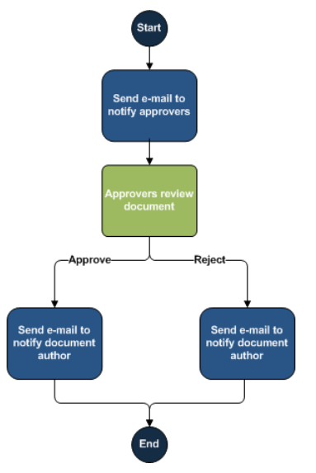
What is a SharePoint workflow
In the context of SharePoint, a workflow is the automated movement of documents or items through a sequence of actions or tasks that are related to a business process.
Notes:
In the context of SharePoint, a workflow is the automated movement of documents or items through a sequence of actions or tasks that are related to a business process. Workflows can be used to consistently manage common business processes within an organization by enabling the organization to attach business logic to documents or items in a SharePoint list or library.
SharePoint workflows are pre-programmed mini-applications that streamline and automate a wide variety of business processes.
Workflows can range from collecting signatures, feedback, or approvals for a plan or document, to tracking the current status of a routine procedure.
SharePoint workflows are designed to save you time and effort, and to bring consistency and efficiency to tasks that you perform on a regular basis.

Slide 6
Classic SharePoint Workflow Platforms
SharePoint 2010 Workflow
SharePoint 2010 workflows, released with SharePoint Server 2010, are hosted, and executed in SharePoint workflow runtime.
SharePoint 2013 Workflow
SharePoint 2013 workflows, released with SharePoint Server 2013, are hosted in SharePoint, and executed in Workflow Manager, that runs independently.
Workflow engine lives in SharePoint
Workflow engine lives outside of SharePoint
As of Nov 2020 SharePoint 2010 Workflow will be retired
Notes:
The evolution of SharePoint workflow
Back in SharePoint 2010, workflows were intended primarily for approval pipelines. Enterprises could use SharePoint Designer and workflow editor to customize their workflows. The workflow process happened within SharePoint itself.
With Workflow Manager, Workflows are hosted outside of SharePoint. Windows Azure Workflow (WAW) is an installable product and can be hosted on an on-premise SharePoint farm. Workflow is now run as a separate service. Communication of workflows with SharePoint will happen via REST / CSOM or OAuth.
SharePoint 2010 Workflow
SharePoint Server 2010
Carried forward to Office 365 and SharePoint Server 2013
Built on top of WF 3.5
Uses SharePoint as execution host
Workflow engine lives in SharePoint
SharePoint 2013 Workflows
SharePoint Server 2013
Carried forward to Office 365
Built on top of WF 4
Workflow engine lives outside of Office 365
For on-premises, Workflow Manager can be installed on SharePoint server

Slide 7
Classic SharePoint Workflow Authoring
SharePoint Designer
SharePoint Designer is the most used application to author and publish classic workflows in SharePoint
Visual Studio
Professional Developers, looking to extend and build more complex workflows, use Visual Studio to create and publish workflows in SharePoint.
Specific to SharePoint only
Target Users: Information workers, business analysts, SharePoint developers
Target users: Intermediate or advanced software developers
Notes:
SharePoint Designer:
Lots of workflow actions are available in SharePoint Designer but all the actions are specific to SharePoint only. You need development knowledge to communicate with various services from SharePoint designer.
Among the greatest advantages of the workflow framework in SharePoint is the ease with which information workers can use the no-code environment of SharePoint Designer to create rich and powerful workflows.
Target Users: Information workers, business analysts, SharePoint developers
Difficulty level: Familiarity with SharePoint Designer, including the core workflow components, such as stages, gates, actions, conditions, and loops.
Visual Studio:
Additionally, a high degree of flexibility and customization is available in a declarative authoring environment such as Visual Studio.
Target users: Intermediate or advanced software developers.
Difficulty level: Familiarity with Visual Studio, including software development concepts such as event receivers, packaging and deployment, and security.

Slide 8
The Current Landscape
For building process automations in SharePoint today and into the future, flows within Microsoft Power Automate is the tool of choice
Classic Workflow
Power Automate
Notes:
SharePoint has evolved…
How we do business has evolved…
Business process has evolved…
Modern experience in SharePoint is
designed to be compelling, flexible,
and more performant.
Modern experience in SharePoint integrates with
rest of the Microsoft 365 apps & services driving security,
productivity and collaboration.
Power Platform is preferred Microsoft 365 Business Application Platform
for building custom applications and orchestrate workflows.

Slide 9
Power Automate Introduction

Slide 10
Modern SharePoint Workflow Authoring
Power Automate
Tightly integrated with SharePoint Online but it is not limited to just SharePoint as it can connect to hundreds of popular apps and services
Power Automate is one of the pillars of Power Platform and is the recommended workflow tool for SharePoint
Powerful workflow automation with a no-code/low-code approach
Notes:
SharePoint Designer is part of the SharePoint family, has been around since 2010. It lets you modify SharePoint sites, workflows, and webpages.
Power Automate is a cloud-based software that lets you automate tasks and workflows across many applications and services
Power Automate can be used with hundreds of applications and platforms. SharePoint Designer only works with SharePoint.
SharePoint Designer workflows also only work within a single site. Power Automate can go between sites, site collections and even different tenants and farms.
Power Automate is much more extendable in terms of business automation.
Lots of workflow actions are available in SharePoint Designer but all the actions are specific to SharePoint only. You need development knowledge to communicate with various services from SharePoint designer.

Slide 11

Work less, do more
Microsoft Power Automate helps non-developers work smarter by automating workflows across apps and services
Get notifications
Copy files
Collect data
Automate approvals

Slide 12
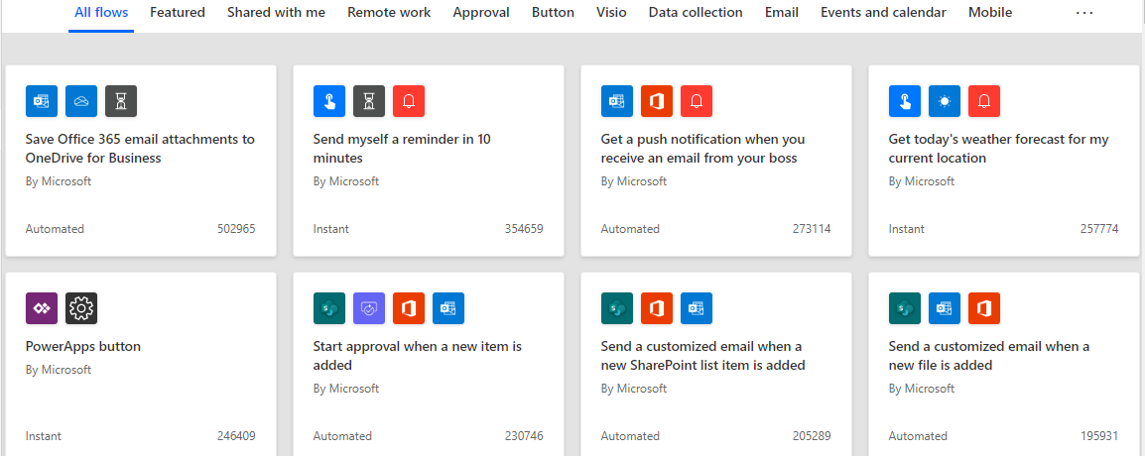
Power Automate Templates
1000s of predefined templates are available to use
Notes:
As compared to the set of predefined templates offered in SharePoint Designer, Power Automate Flow not only offers more out-of-the-box options, it also allows users to create their own custom templates that can be shared with the community.
Each template is designed for a specific purpose. For example, there are templates for sending you a text message when your boss emails you, adding Twitter leads to Dynamics 365, or backing up your files. These templates are just the tip of the iceberg. They're intended to inspire you to create customized flows for the exact processes you need.

Slide 13
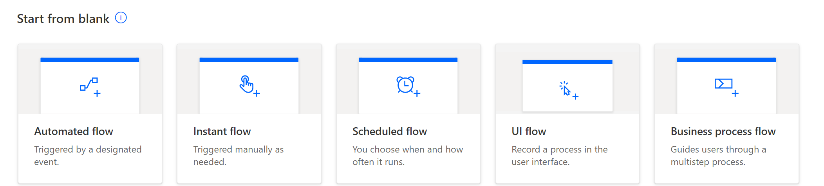
Start a new Flow from Blank

Slide 14
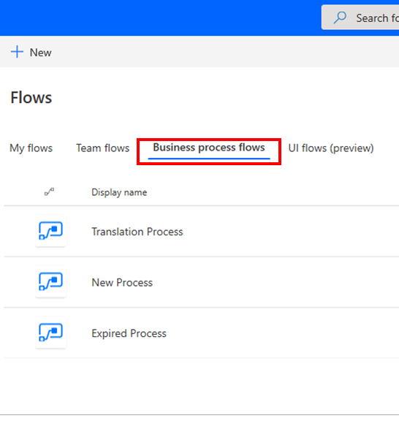
Differences between a business process flow and a regular flow in Power Automate
Business Process flow
is a visual guide
Users are not limited on how long they run a business process
All data can only be stored in one or more entities in Common Data Service
cannot be associated with another data source behind it.
Regular flow
does not have any visual components
can be configured to work with many different data sources
can connect to many different data sources within the same flow.
A flow can be configured to time out if it is not completed in a certain time
can be triggered to move between steps based on data or user interaction.
supports complex logic and looping
can call another Power Automate flow as needed.
Notes:
A business process flow is a visual guide that is meant to help users complete a business process by using a set of predefined stages. Users are not limited on how long they run a business process or how long they have a stage open. All data that is associated with the business process flow can only be stored in one or more entities in Common Data Service, and you cannot associate a business process flow with another data source behind it.
A Power Automate flow does not have any visual components like a business process flow. Power Automate flows can be configured to work with many different data sources and a flow can connect to many different data sources within the same flow. A flow can be configured to time out if it is not completed in a certain time and can be triggered to move between steps based on data or user interaction. Flows support complex logic and looping and a Power Automate flow can call another Power Automate flow as needed.

Slide 15






SharePoint Power Automate Integrations
Set a reminder
Request sign-off
Content approvals
Personal reminder for a date column
No set up required approval flow
Require approval for items and docs in your flows
Page approvals
Hub join approvals
Create your own…
Require approval for SharePoint pages
Require approval for hub site associations
Create your own flow from templates
Notes:
Request sign-off - The goal is to provide you an easy way to send an item for approval to someone else. This feature enables an open approval process that allows you to easily record whether or not a document or list item was approved or not. There is no setup required.
Set a reminder - With Power Automate's integration with SharePoint, you can easily create reminder flows, based on DateTime columns in SharePoint. With reminder flows, you receive a personal email alert a predetermined number of days in advance of a date on any document or item in SharePoint.
Page Approvals - SharePoint site admins can use Power Automate to require new or updated site pages to be approved before being published.

Slide 16
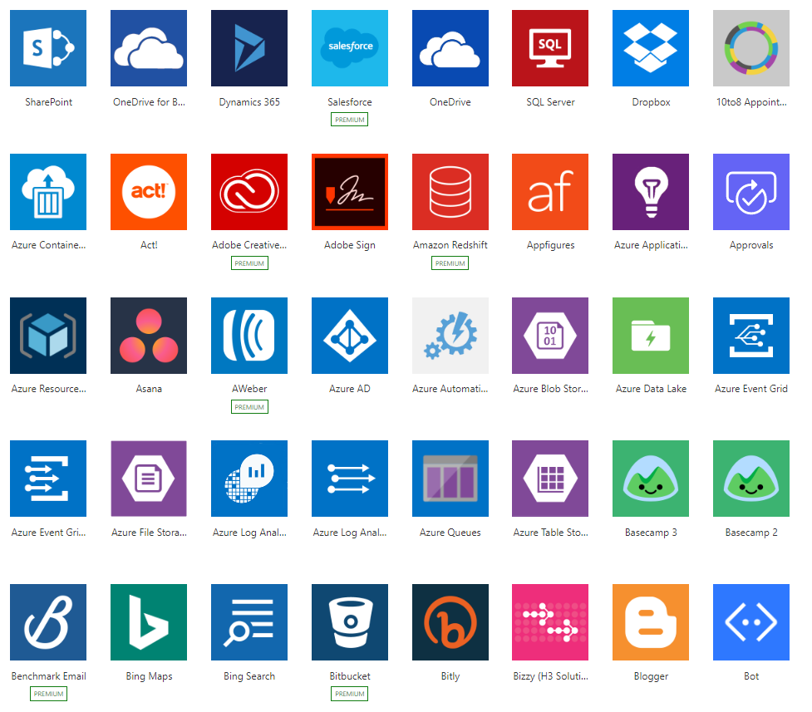
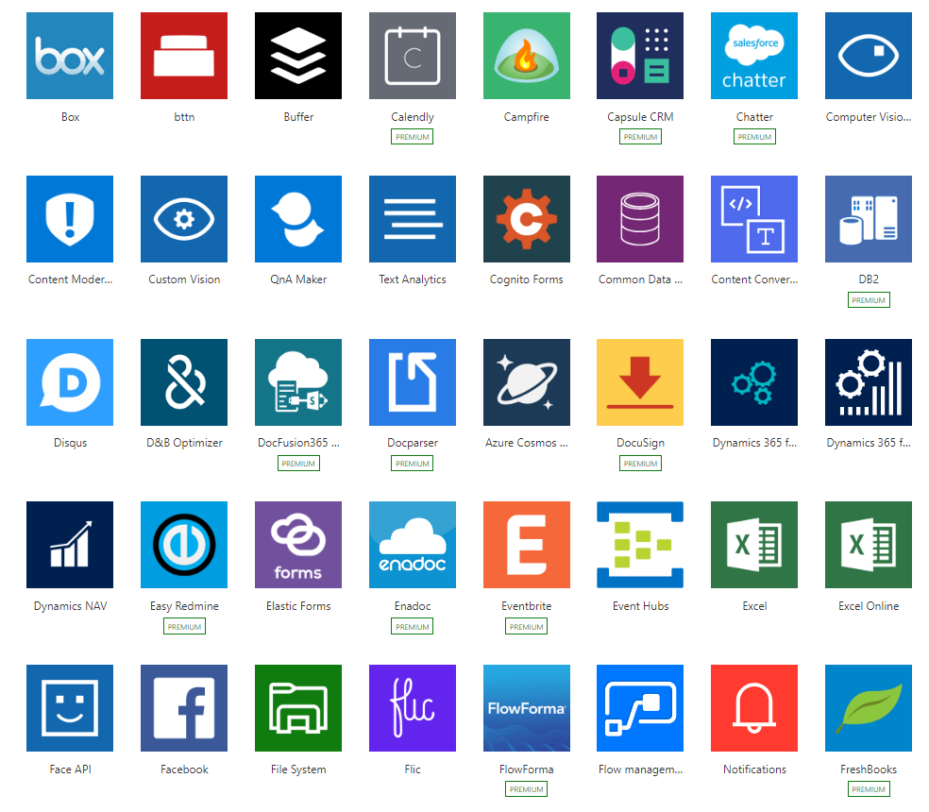
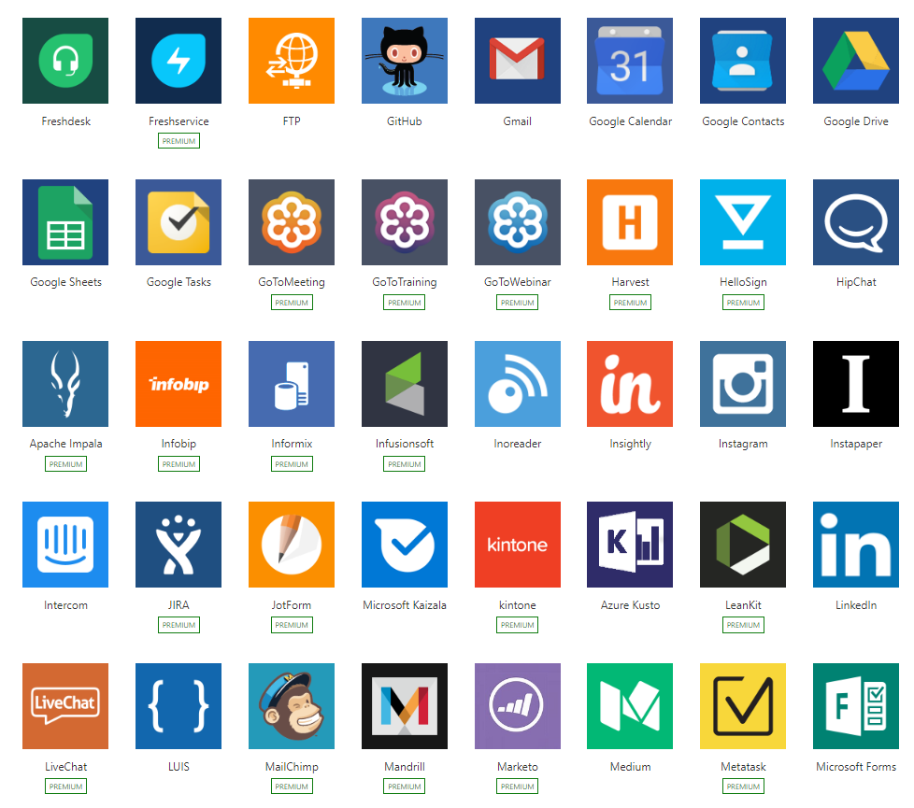
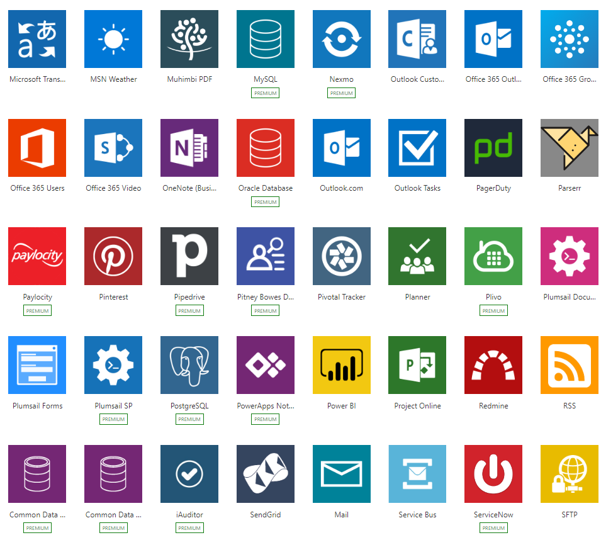
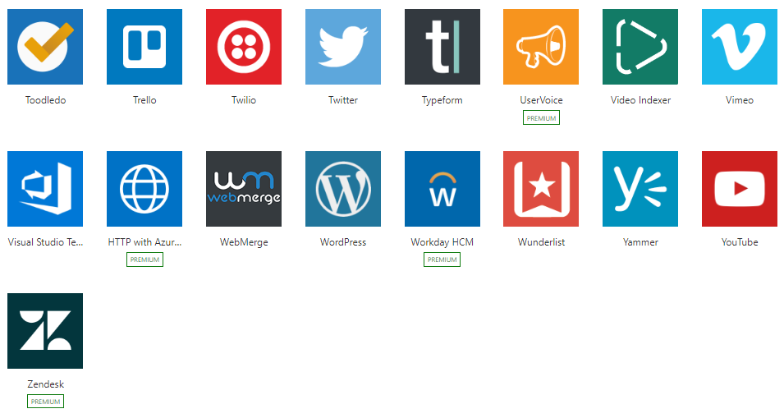
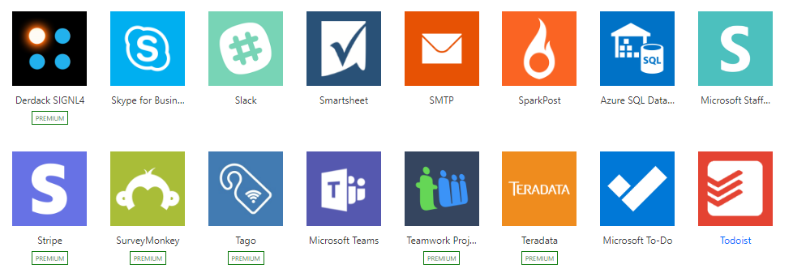
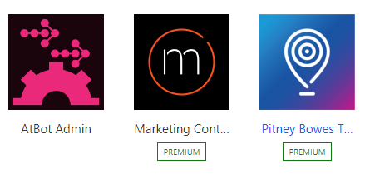
Power Automate Connectivity
Built-in connectivity to 300+ SaaS cloud services, file providers, databases, web APIs, productivity apps, and more
Pluggable extensibility via Custom Connectors to integrate existing LOB systems
Connect to on-premises systems via Data Gateway
Notes:
Power Automate can be used with hundreds of applications and platforms. SharePoint Designer only works with SharePoint.

Slide 17

Power Automate Mobile App
Download the Power Automate mobile app for Android, iOS, or Windows Phone. With this app, you can:
Monitor flow activity
Manage your flows
Create flows from templates

Slide 18
Office 365 licenses that include Power Automate
Office 365 Business Essentials
Office 365 A5 for Students
Office 365 Business Premium
Office 365 Education E3 for Faculty
Office 365 A1 for Faculty
Office 365 Education E3 for Students
Office 365 A1 for Students
Office 365 Education for Homeschool for Faculty
Office 365 A1 Plus for Faculty
Office 365 Education for Homeschool for Students
Office 365 A1 Plus for Students
Office 365 Enterprise E1
Office 365 A3 for Faculty
Office 365 Enterprise E2
Office 365 A3 for Students
Office 365 Enterprise E3
Office 365 A3 for Student Use Benefit
Office 365 Enterprise E3 Developer
Office 365 A5 for Student Use Benefit
Office 365 Enterprise E3 without ProPlus
Office 365 A5
Office 365 Enterprise E5
Office 365 A5 for Faculty
Office 365 Enterprise F1

Slide 19
Summary of Power Automate for Office 365
Plans and capabilities |  | Power Automate for Office 365
Execute workflows | Number of flow runs per month | Unlimited¹
 | Use business process flows for multi-stage processes | -
Connect to your data | Connect to Office 365 data | Yes
 | Use pre-built connectors | Standard Connectors only
 | Use custom and on-premises connectors | -
Store and manage data | Utilize Common Data Service | -
Per license capacity¹ | Daily API Requests¹ | 2,000
¹ Usage capacity is across both Power Apps and Power Automate; “Power Apps and Power Automate capacity add-on” can be purchased to increase daily service limits. More details at http://aka.ms/platformlimits
Notes:
The scope of this training is to not get deep into licensing, if more info on Power Automate licensing is desired please refer to the following Power Platform licensing guide https://go.microsoft.com/fwlink/?linkid=2085130

Slide 20
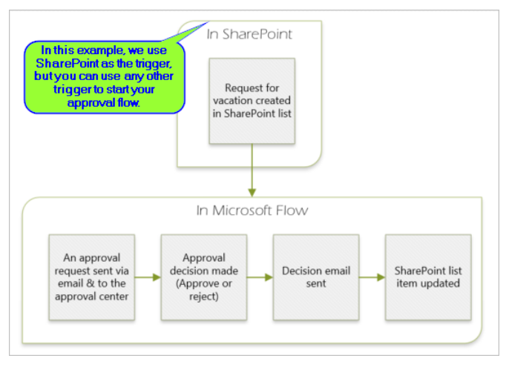
Approval Tasks in Power Automate
With Power Automate, you can manage the approval of documents or processes across several services, including SharePoint, Dynamics 365, Salesforce, OneDrive for Business, Zendesk, or WordPress.
To create an approval workflow, add the Approvals - Start an approval action to any flow. After you add this action, your flow can manage the approval of documents or processes.
Approvers can respond to requests from their email inbox, the approvals center on the Power Automate website, or the Power Automate app.

Slide 21

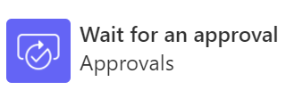

Approval Actions
Starts an automated approval process but does not wait for the approval to complete. The approval is cancelable.
Waits for a specified approval to complete.
Starts an automated approval process and then waits for it to complete. The approval is cancelable.

Slide 22
SharePoint Designer vs Power Automate: Comparisons

Slide 23
SharePoint Designer Vs Power Automate – Building Blocks
SharePoint Workflows
SharePoint Site
Triggers
Conditions
/Loops
Actions
Power Automate
300+ Data sources
Triggers
Conditions
/Loops
Actions
Notes:
As we can see in this graphic on the left side, we find the behavior of SharePoint Flows whose only source of data comes from SharePoint Online or On premises sites.
On the right side we see that Power Automate contains the same features such as Triggers, conditions and actions, but has more than 300 (three hundred), connections to data sources.

Slide 24
SharePoint Designer Workflow Types
Workflow Type | Use Case
List and Library workflows | Applies to either documents in a document library or a SharePoint list that holds structured data. A common application of a library workflow is to enable a process for approving documents
Reusable workflows | Do not rely on a specific list but can be associated with any list. Further, the workflow design can be reused and associated with multiple lists
Site workflows | Implements a process that does not start as a result of a list item or document and must be initiated manually through the SharePoint UI or SharePoint API. It is also helpful if the workflow must monitor actions that occur in several places across the site.
Notes:
SharePoint Designer is part of the SharePoint family, has been around since 2010 [two thousand ten]. It lets you modify SharePoint sites, workflows, and webpages.
Power Automate is a cloud-based software that lets you automate tasks and workflows across many applications and services
Power Automate can be used with hundreds of applications and platforms. SharePoint Designer only works with SharePoint.
SharePoint Designer workflows also only work within a single site. Power Automate can go between sites, site collections and even different tenants and farms.
Power Automate is much more extendable in terms of business automation.
List and library workflows Usually, a workflow applies to a specific repository of items—either documents in a document library or a SharePoint list that holds structured data. A common application of a list workflow is to enable a process for approving documents.
Reusable workflows Even with no-code development, it can take substantial time and analysis to build workflows. In earlier versions of SharePoint, workflows applied to a single list or library only. In SharePoint 2010, you can create list workflows that have full reusability and exportability. These reusable workflows do not rely on a specific list but can be associated with any list. Further, the workflow design can be reused and associated with multiple lists. In addition, you can use the Save as Template command to create a SharePoint solution package (,wsp file) that contains a reusable workflow; this workflow can be moved to another SharePoint server or to Microsoft Visual Studio 2010 [two thousand ten]. .
Site workflows Workflows can be used with SharePoint 2010 sites. This feature is especially useful when the workflow implements a process that does not start as a result of a list item or document and must be initiated manually through the SharePoint UI or SharePoint API. It is also helpful if the workflow must monitor actions that occur in several places across the site.

Slide 25
Power Automate Workflow Types
Flow Type | Use Case
Automated flows | Create a flow that performs one or more tasks automatically after it's triggered by an event.
Button flows | Run repetitive tasks from anyplace, at any time, via your mobile device.
Scheduled flows | Create a flow that performs one or more tasks on a schedule.
Business process flows | Define a set of steps for people to follow to take them to a desired outcome.
UI flows | Brings Robotic Process Automation (RPA) capabilities to automate repetitive tasks in Windows and Web applications
Notes:
Automated flows - Create a flow that performs one or more tasks automatically after it's triggered by an event. For example, create a flow that notifies you by email when someone sends a tweet that contains a keyword you specify. In this example, sending a tweet is the event, and sending mail is the action.
Button flows - Create buttons so that you can easily run repetitive tasks from any place, at anytime via your mobile device. Running buttons saves you time and, since the tasks they perform are automated, there will be less errors than if you manually did them.
Scheduled flows - Create a flow that performs one or more tasks (such as sending a report in email):
- once a day, an hour, or a minute
- on a date that you specify
- after a number of days, hours, or minutes that you specify
Business process flows - Business process flows provide a guide for people to get work done. They provide a streamlined user experience that leads people through the processes their organization has defined for interactions that need to be advanced to a conclusion of some kind. This user experience can be tailored so that people with different security roles can have an experience that best suits the work they do.
UI flows - UI flows brings Robotic Process Automation (RPA) capabilities to Power Automate. You can use UI flows to automate repetitive tasks in Windows and Web applications. UI flows records and plays back user interface actions (clicks, keyboard input, etc.) for applications that don't have easy-to-use or complete APIs available.
More info here = https://docs.microsoft.com/en-us/power-automate/getting-started

Slide 26
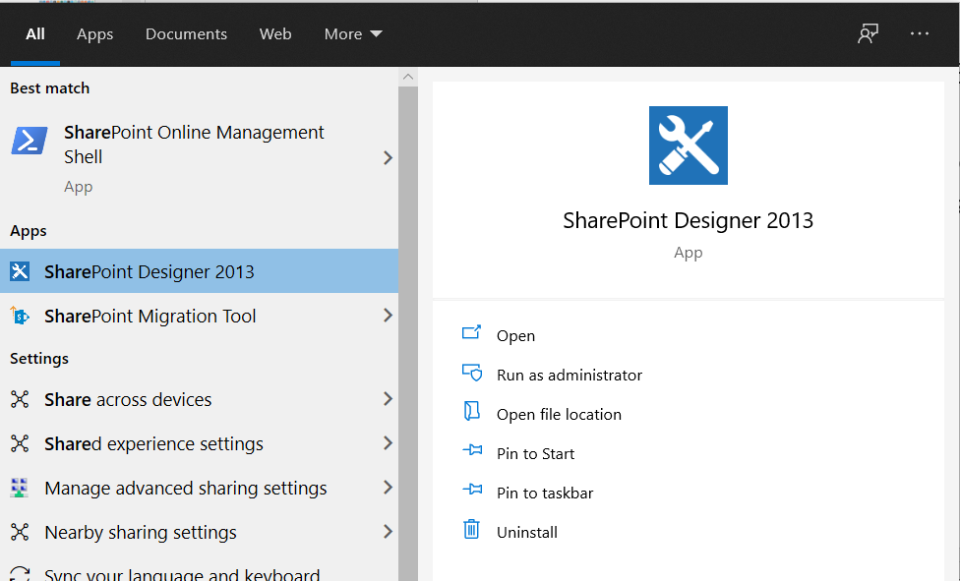
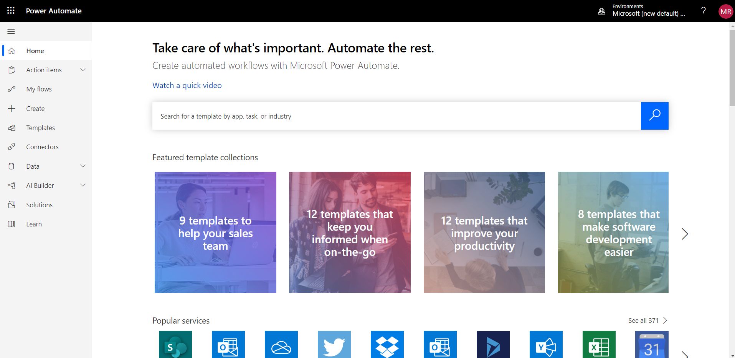
Environment Comparison
SharePoint Designer is a separate software Installation (last released version is 2013)
Power Automate does not require installation, only a browser and internet connection are necessary
Flow.Microsoft.com
Notes:
SharePoint Designer was first introduced in 2007. Its primary objectives were two-fold: design customization and business automation. Design customization over time was learned to be a not so good idea. Web coding standards have evolved to be more scalable, faster and more secure. Design styles have changed drastically even from 2007. Business automation however has been and always will be a cornerstone of why people love to use SharePoint.
SharePoint Designer (SPD) has evolved greatly since 2007. 2 newer iterations have launched since then; SPD 2010 and 2013. SPD 2010 included everything 2007 did and much more. SPD 2013 on the other hand left out some goodies that SPD 2010 had, but you could at least still create and run SPD 2010 workflows within SPD 2013. Fast forward to today and no new SharePoint Designer has been launched since then. This includes the launches of SharePoint 2016, 2019 and Online.

Slide 27
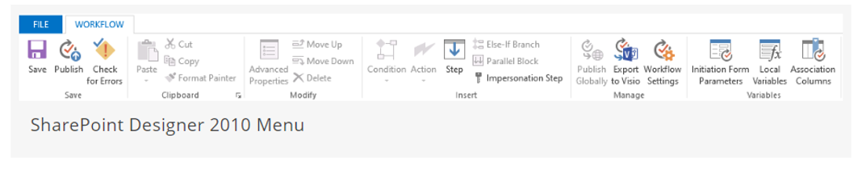
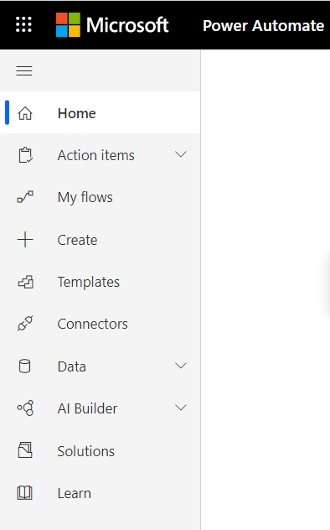
Navigation Comparision
The SharePoint Designer user interface is focused at the top ribbon
Power Automate groups functional aspects together via the left Navigation menu
Notes:
SharePoint Designer Ribbon: The ribbon up top has most of the stuff you need, with the editor in the main page area. This will contain your workflow stages (and steps), which contain conditions and actions that are executed in sequence top down.
[Info Video]

Slide 28
SPD Workflow Tasks vs Power Automate Tasks
SharePoint Designer
Power Automate
By using designer workflow you can assign a task or work to a Group or a single person
After assigning the task to a group or a single person, We can track that current task status to know whether it is progressing or not
Leverages more simplistic concepts of Create Item and Update Item actions to manage the creation and updating of SharePoint tasks
To create a SharePoint task You need to add a new item into specific SharePoint task lists
Notes:
SharePoint Designer Workflow is an automated business process which is used for automating your business activities. By using designer workflow you can assign a task or work to a Group or a single person. After assigning the task to a group or a single person, We can track that current task status to know whether it is progressing or not.
Microsoft Power Automate is tightly integrated to SharePoint Online but it is not only used for SharePoint, then to create a SharePoint task you need to add a new item into specific SharePoint task lists
Microsoft Power Automate leverages the more simplistic concepts of Create Item and Update Item actions to manage the creation and updating of SharePoint tasks.

Slide 29
SharePoint Built in OOB Workflows vs Power Automate equivalent options
SharePoint Built-in Workflows | Power Automate
Approval | When a file is added, approve file using SharePoint Content Approval
Collect Signatures | Requires 3rd party connector
Publishing Approval | There are several Approval templates that can be tweaked to mimic the functionality
Collect Feedback | Request feedback templates

Slide 30
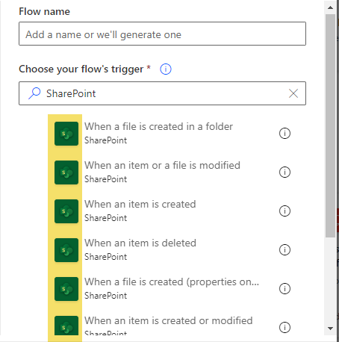
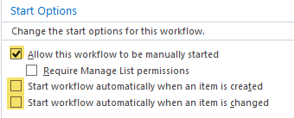
Triggers Comparison
SharePoint Designer
Power Automate
Triggers in SPD Workflow
Triggers in Power Automate flow for SharePoint
Notes:
Note: currently in Power Automate you cannot have manual start and created by/modified by triggers in same Power Automate flow, at the time of writing it would require 2 workflows if the requirement is to have manual trigger and created/modified trigger.

Slide 31
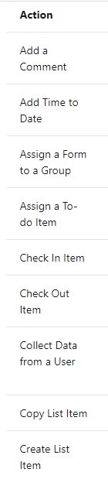
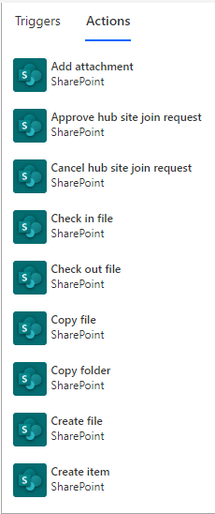
Actions Comparison
SharePoint Designer
Power Automate
Actions in Power Automate are the same in concept as actions in Designer workflows
Actions are the "verb" - they do the work
If steps are the "where" and conditions are the "when," actions are the critical "what" piece of the workflow story
Notes:
SharePoint Designer Actions
If steps are the "where" and conditions are the "when," actions are the critical "what" piece of the workflow story.
An action can be anything—from working with an item associated with the workflow, to sending email to a certain participant, to updating another data repository.
You can build custom actions, but SharePoint Designer 2010 includes a comprehensive set of actions that enables you to build even complex examples of most common business processes in SharePoint 2010.
Power Automate
Actions in Power Automate are the same in concept as actions in Designer workflows.
Actions are the "verb" - they do the work.
Currently, there are many SharePoint actions (with more planned).

Slide 32
SharePoint Designer vs Power Automate Actions - List Items
SharePoint Designer | Power Automate
Create List Item | Create item
Delete Item | Delete item
Set Field in Current Item | Update item
Update List Item | Update item
Wait for Event in List Item | Do until
Wait for Field Change in Current Item | Do until

Slide 33
SharePoint Designer vs Power Automate Actions - Files
SharePoint Designer | Power Automate
Check In Item | Check in item
Check Out Item | Check out item
Copy Document | Copy file
Discard Check Out Item | Discard check out
Translate Document | Translator

Slide 34
SharePoint Designer vs Power Automate Actions - Users and Permissions
SharePoint Designer | Power Automate
Lookup Manager of a User | Get manager
Add List Item Permissions | Grant access to an item or a folder
Not Available | Stop sharing an item or a folder
Inherit List Item Parent Permissions | Not Available
Remove List Item Permissions | Not Available

Slide 35
SharePoint Designer vs Power Automate Actions - Workflow
SharePoint Designer | Power Automate
Add a Comment | Rename and add comments within any action or condition
Set Workflow Status | Not applicable. Unless you want to set a field in a SharePoint list item or a database record
Log to History List | No built-in monitoring status of actions in progress within SharePoint – other alternatives
Set Workflow Variable | Variables are very Powerful Advanced feature
Start a List Workflow | Starting a SharePoint Designer workflow then you could use the REST API
Start a Site Workflow | Starting a SharePoint Designer workflow then you could use the REST API
Collect Data from a User | Power Apps / SharePoint List
Go to Stage | Do until
Pause for Duration | Delay
Pause until Date | Delay until

Slide 36
SharePoint Designer vs Power Automate Actions - Tasks
SharePoint Designer | Power Automate
Start a Task Process | Power Automate leverages the more simplistic concepts of Create Item and Update Item actions to manage the creation and updating of SharePoint tasks
Assign a Task | Implementing a task system can be achieved in multiple ways
Assign a To-do Item
Start Custom Task Process

Slide 37
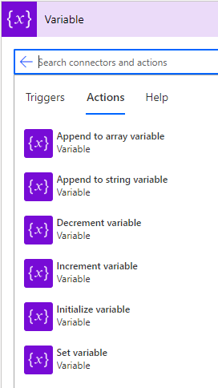
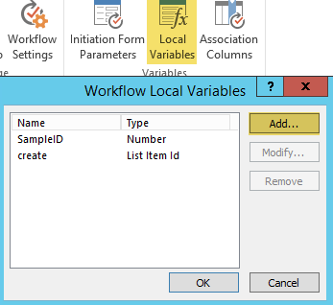
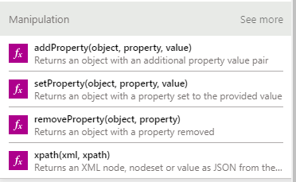
Variables Comparison
SharePoint Designer
Power Automate
Variables are a bit different in Flow. Dynamic content will take away the need of creating many variables. As an alternative you can set properties with expressions:
Notes:
Think of variables as temporary storage of values while a workflow is running. Variables are available in any step / action / condition in the workflow/Flow once defined.

Slide 38
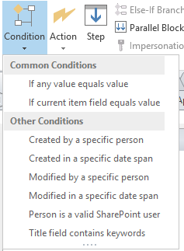
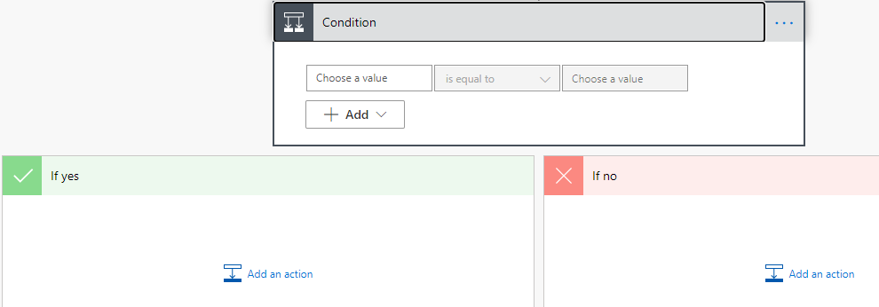
Conditions Comparison
SharePoint Designer
Power Automate
By leveraging variables and dynamic expressions in a Condition step, the functionalities that are available in SPD workflows can be achieved in Power Automate flow
Notes:
SharePoint Designer:
Where to find the workflow conditions
There are two ways to access the menu of available workflow conditions.
While you are editing inside a workflow step, do one of the following:
On the Workflow tab, in the Insert group, click Conditions to open the list of workflow actions.
Double-click inside a workflow step. In the search box that appears, type text that appears in the name of the condition that you want, such as "created", and then press Enter. Actions and conditions that contain the text you typed appear after the text box.
Which conditions are available to you while you are creating or modifying a workflow depends on the precise context that you are working in.
Power Automate:
Specify that a flow performs one or more tasks only if a condition is true. For example, specify that you'll get an email only if a tweet that contains a keyword is retweeted at least 10 times.
Add a condition
In Power Automate, select My flows.
You might need to sign in if you're not already signed in.
Select one of the flows from My flows, and then select More commands (the three dots).
This tutorial uses an example with a Twitter trigger and a SharePoint action.
Select Edit.
Under the last action, select New step > Condition.
On the Condition card, select an empty area in box on the left.
The Dynamic content list opens.
Select the Retweet count parameter to add it to the box.
In the box in the middle of the Condition card, select is greater than or equal to.
In the box on the right, enter 10.
Now that you've configured the condition, continue with the following steps to send an email if the Retweet count is more than 10.
Select Add an action on the If yes send of the condition.
Enter Send an email into the search box, and then select Send an email (V2).
Configure the Send an email (V2) card to your liking, indicating the contents of the email that the flow sends if the Retweet count is greater than 10.
You can also configure the If no side of the condition if you'd like to take an when the Retweet count is less than 10.
Save the flow.

Slide 39
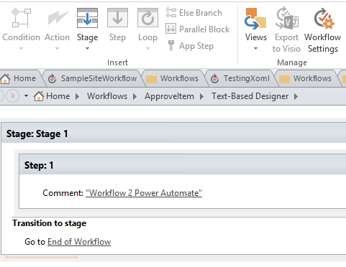
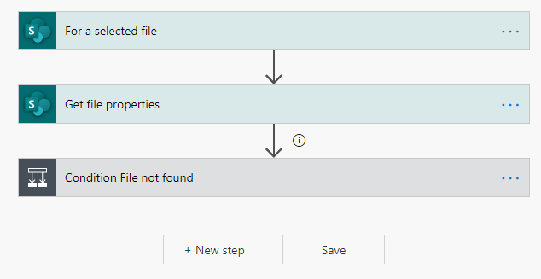
Stages/Steps Comparison
SharePoint Designer
Power Automate
Steps
Notes:
Steps : Steps are the primary means of structure and organization within a workflow or Flow. A step contains one or more actions and, optionally, one or more conditions.

Slide 40
Differences between a business process flow and a regular flow in Power Automate
Business Process flow
is a visual guide
Users are not limited on how long they run a business process
All data can only be stored in one or more entities in Common Data Service
cannot be associated with another data source behind it.
Regular flow
does not have any visual components
can be configured to work with many different data sources
can connect to many different data sources within the same flow.
A flow can be configured to time out if it is not completed in a certain time
can be triggered to move between steps based on data or user interaction.
supports complex logic and looping
can call another Power Automate flow as needed.
Notes:
A business process flow is a visual guide that is meant to help users complete a business process by using a set of predefined stages. Users are not limited on how long they run a business process or how long they have a stage open. All data that is associated with the business process flow can only be stored in one or more entities in Common Data Service, and you cannot associate a business process flow with another data source behind it.
A Power Automate flow does not have any visual components like a business process flow. Power Automate flows can be configured to work with many different data sources and a flow can connect to many different data sources within the same flow. A flow can be configured to time out if it is not completed in a certain time and can be triggered to move between steps based on data or user interaction. Flows support complex logic and looping and a Power Automate flow can call another Power Automate flow as needed.

Slide 41
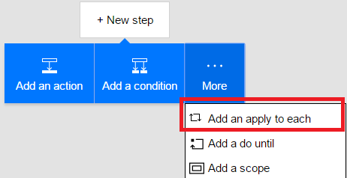
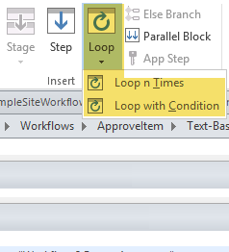
Looping Comparison
SharePoint Designer
Power Automate
In some business process, you will get a list of items returned by an action. An apply to each loop makes it possible to control the list that you repeat over. To add a loop, first click New Step and then select More.
A do-until loop allows you to repeat a step until a certain condition is met. The most common reason to use this is in approval scenarios.
In SharePoint Designer 2010 it was not possible to create loops in workflows (or only in a quite painful way…). In SharePoint Designer 2013 there is a Loop activity which supports looping.
Notes:
Loop in SharePoint Designer Workflow :
One of the major limitations in SharePoint Designer-based workflows in SharePoint 2010 was the inability to loop in workflows. 2013 workflows in SharePoint Designer can now include looping. There are two types of looping available: Loop n Times and Loop with Condition.
The Loop n Times loop type allows a designer to create a looping condition where the actions contained in the loop container are executed several times. One or more workflow actions can be placed in the loop and the workflow will execute these actions (in order) for the number of loop iterations specified.
The Loop with Condition loop type allows a designer to create a looping condition where the actions contained in the loop container are executed until a specified condition is met. Just like the Loop n Times loop type, the workflow actions placed in the loop will execute in order, and the loop will continue to execute these actions until the loop condition is met.
Restrictions in SPD Workflow Looping construct:
Loops must be contained within a stage
You cannot add a stage inside a loop
Loops can only have one entry and one exit point
Nested loops are also supported if the need for executing a series of actions in an inner loop is desired.
Power Automate Loop:
Frequently, you will get a list of items returned by an action. For example, you could get a list of email attachments for new emails, or a list of search results from a search API. An apply to each loop makes it possible to control the list that you repeat over. You can also use a condition inside of an apply to each to filter the array. To add new control flow concepts like Apply to each or Do-until, first click New Step and then select More.
This will add a shape to the designer that you can choose an array in.
A do-until loop allows you to repeat a step until a certain condition is met. The most common reason to use this is in approval scenarios. For example, you can create a new record in a database, wait until a certain field in that record is “Approved”, and then continue the flow.

Slide 42
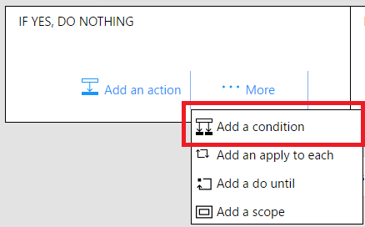
Looping in Power Automate
Power Automate
Previously, you could have a single if-else statement, but that was the full extent of logic that was supported. Now you can add a second (or third, etc.,) condition inside another. To do this, there is an option to Add a condition, even when you are inside another condition !

Slide 43
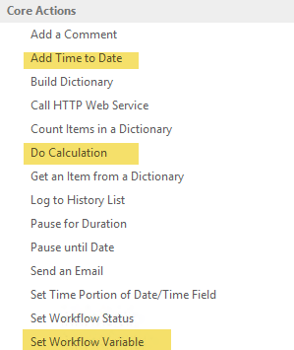
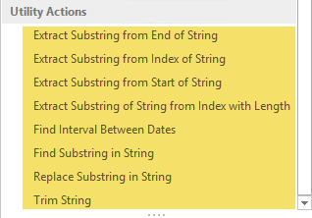
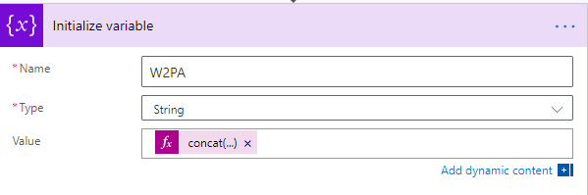
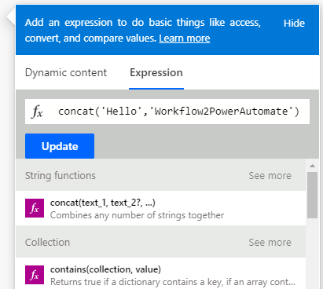
Expressions Comparison
SharePoint Designer
Power Automate
With Designer workflows, we had to a limited set of string manipulation actions and several calculation actions.
Notes:
Expressions are a rich set of Excel-like formulas that allow you to manipulate data.
With Designer workflows, we had a limited set of string manipulation actions and several calculation actions. If you were ever frustrated by what you couldn't do with strings in Designer workflows, Flow Expressions will make you smile.
In addition to string functions, additional function groups include date, math and conversion. Once again, this type of functionality would have been very welcome in Designer workflows.

Slide 44
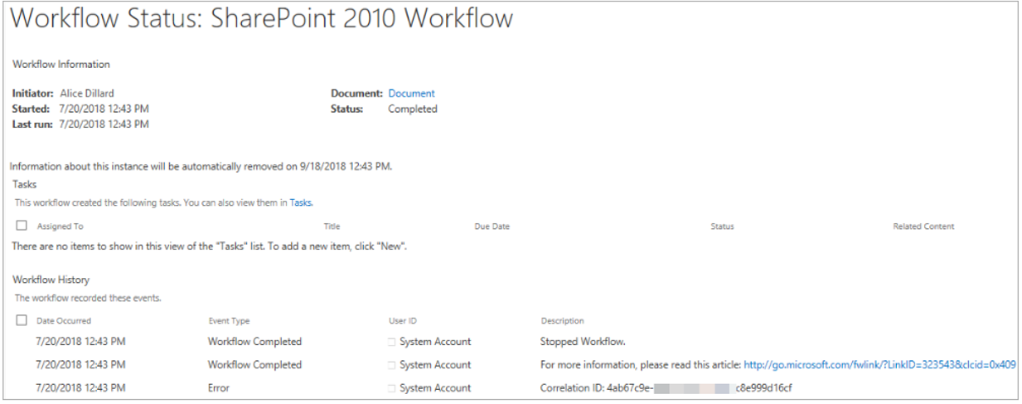
How to check workflow instances - difference
Name of the person who started the workflow
Date and time the workflow started
Date and time the workflow was last run
Name and link to the document
Item involved in the workflow
Current status of the workflow
The option to terminate the workflow
SharePoint Workflow
The Workflow Status page provides the following information and options:
Notes:
SharePoint Workflow
The Workflow Status page provides the following information and options:
Name of the person who started the workflow.
Date and time the workflow started.
Date and time the workflow was last run.
Name and link to the document or
item involved in the workflow.
Current status of the workflow.
The option to terminate the workflow.

Slide 45
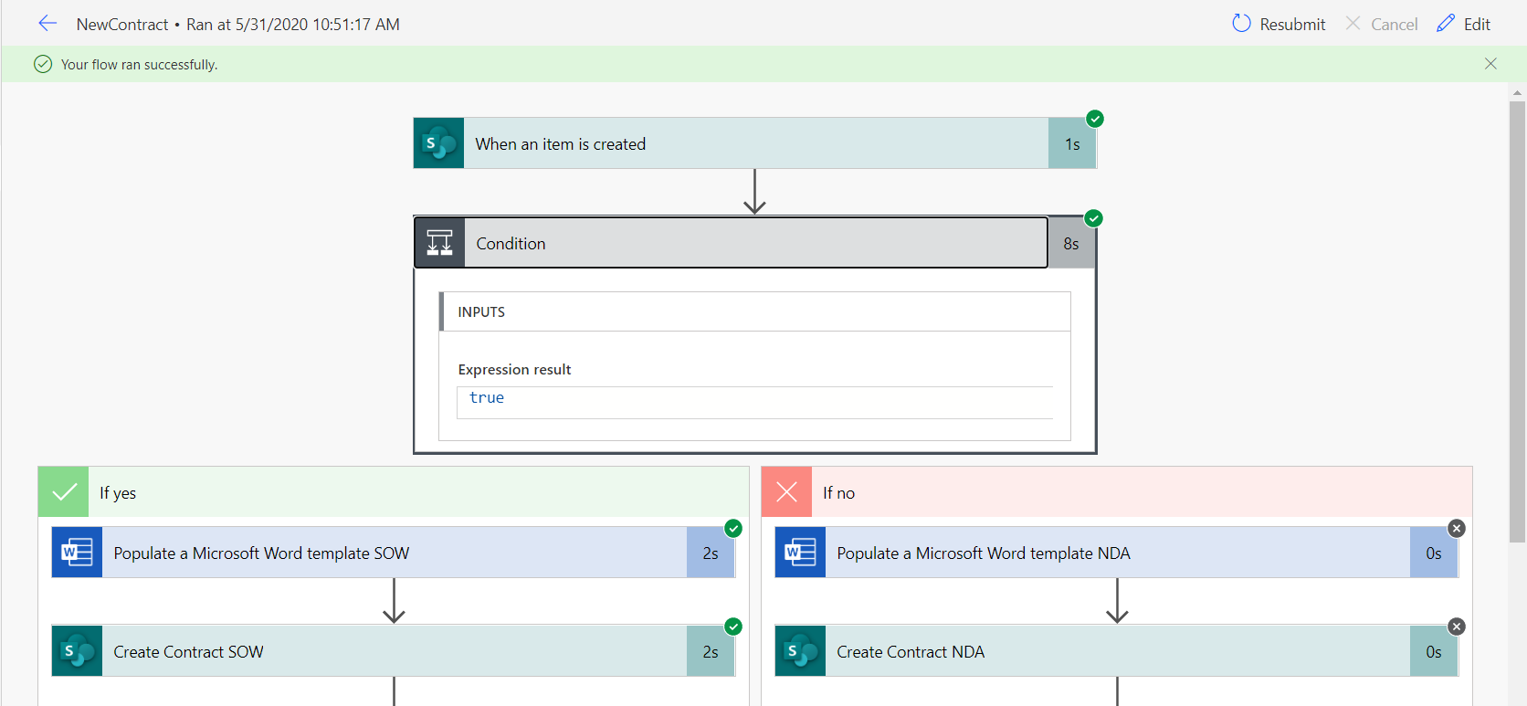
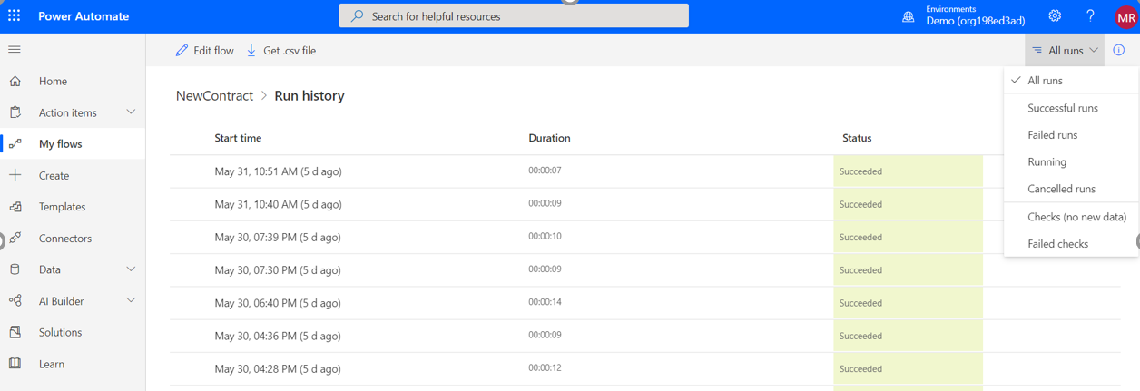
How to check workflow instances - difference
Power Automate
You can see the Run history for each flow that you have
History retention is 30 days

Slide 46
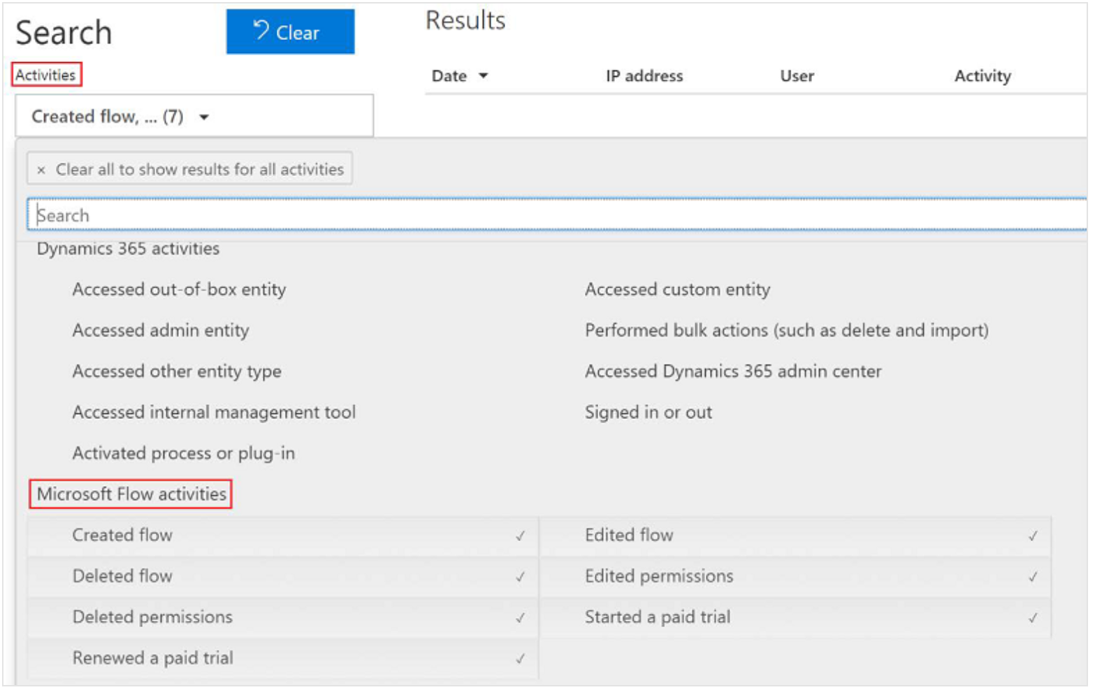
Power Automate Audit Log Events
In the compliance center Audit Log Search administrators can search and view Power Automate events
Events include:
Created flow
Edited flow
Deleted flow
Edited Permissions
Deleted Permissions
Started a paid trial
Renewed a paid trial

Slide 47
Transformation Tips

Slide 48
Workflow to Power Automate Best Practices
Best Practices | Use Case
Provide Power Automate training to user community | It is not uncommon for an organization to have 1000+ workflows that could be transformed to Power Automate. Many IT teams will not have the resources to manage this effort on their own and will require assistance from the user community
Reusable workflows | Do not rely on a specific list but can be associated with any list. Further, the workflow design can be reused and associated with multiple lists
Site workflows | Implements a process that does not start as a result of a list item or document and must be initiated manually through the SharePoint UI or SharePoint API. It is also helpful if the workflow must monitor actions that occur in several places across the site.
Notes:
SharePoint Designer is part of the SharePoint family, has been around since 2010. It lets you modify SharePoint sites, workflows, and webpages.
Power Automate is a cloud-based software that lets you automate tasks and workflows across many applications and services
Power Automate can be used with hundreds of applications and platforms. SharePoint Designer only works with SharePoint.
SharePoint Designer workflows also only work within a single site. Power Automate can go between sites, site collections and even different tenants and farms.
Power Automate is much more extendable in terms of business automation.
List and library workflows Usually, a workflow applies to a specific repository of items—either documents in a document library or a SharePoint list that holds structured data. A common application of a list workflow is to enable a process for approving documents.
Reusable workflows Even with no-code development, it can take substantial time and analysis to build workflows. In earlier versions of SharePoint, workflows applied to a single list or library only. In SharePoint 2010, you can create list workflows that have full reusability and exportability. These reusable workflows do not rely on a specific list but can be associated with any list. Further, the workflow design can be reused and associated with multiple lists. In addition, you can use the Save as Template command to create a SharePoint solution package (,wsp file) that contains a reusable workflow; this workflow can be moved to another SharePoint server or to Microsoft Visual Studio 2010.
Site workflows Workflows can be used with SharePoint 2010 sites. This feature is especially useful when the workflow implements a process that does not start as a result of a list item or document and must be initiated manually through the SharePoint UI or SharePoint API. It is also helpful if the workflow must monitor actions that occur in several places across the site.

Slide 49
Power Automate End User Training
It is not uncommon for an organization to have 1000+ workflows that could be transformed to Power Automate
Many IT teams will not have the resources to manage this effort on their own and will require assistance from the business user community
Best Practice Guidance | Example Plan:
Work with your organizations BDMs and Microsoft Account Team to propose a training plan to ramp up the user community on Power Automate | WorkshopPLUS - Microsoft Power Automate: Power User 1 Day with Lab Power Platform hackathon engagements O365 Days learning events On-demand trainings Customer success training programs for Power Automate

Slide 50
Workflow Transformation Tracking
It is not uncommon for an organization to have 1000+ workflows that could be transformed to Power Automate
Many IT teams will not have the resources to manage this effort on their own and will require assistance from the business user community
For an initiative such as classic 2010 workflow retirement it is imperative that the Project team be able to track progress
Best Practice Example | Example Plan:
Create an attestation process in which workflow owners will be responsible for updating the status of their workflow transformations in a master list | Compile a master list of all workflows and workflow owners Communicate to workflow owners on how to manage and update their workflow transformation progress Use a SharePoint list as an example and create a default view that defaults to “assigned to me” so when a workflow owner accesses, they will only see the workflows they own by default

Slide 51
Workflow Status Column
In classic SharePoint workflows it was very common for the workflow to update a workflow status column in which end users are used to monitoring in order to track workflow progress
At the time of this writing Power Automate does not have a default OOTB option to track workflow status within a SharePoint list/library column
Best Practice Example | Example Plan:
Workflow owners can add logic to the Power Automate Flow to achieve a similar result | Can add an Update Item action within the workflow to update a SharePoint list/library column is approved or rejected

Slide 52
Workflow History List
In classic SharePoint workflows it was very common for the workflow to log to a workflow history list to keep track of workflow progress and key data points
Best Practice Example | Example Plan:
Workflow owners can add logic to the Power Automate Flow to achieve a similar result | Flows maintain a history in the context of the flow itself in the Power Automate dashboard. If you need tracking in your sites, you can have the flow log information in a list you create.

Slide 53
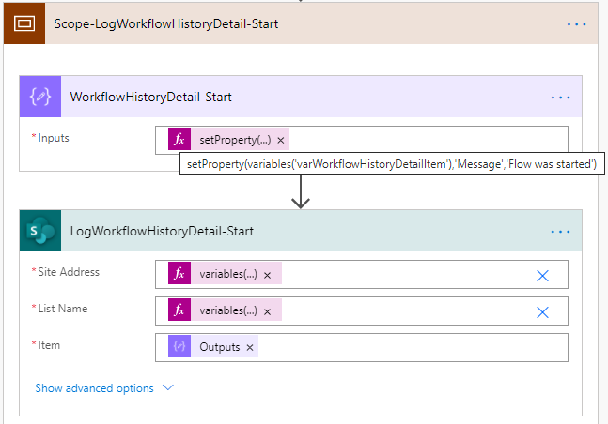
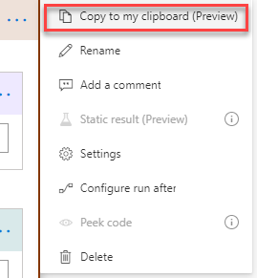
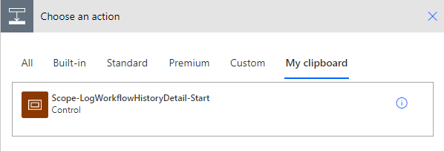
Workflow History List - Sample
Leveraged one or multiple separate SPO lists to log the Power Automate Flow information. Such as status, information and approval details
Used separate Power Automate Flow to provisioning Workflow History list
Log information to WorkflowHistory lists. reference sample from SP2010WorkflowToPowerAutomate
Leveraged “copy to clipboard” and add action from “My clipboard” to reuse a log action in multiple places
Please reference to SP2010WorkflowToPowerAutomate for samples how to create workflow history lists and log information to them

Slide 54
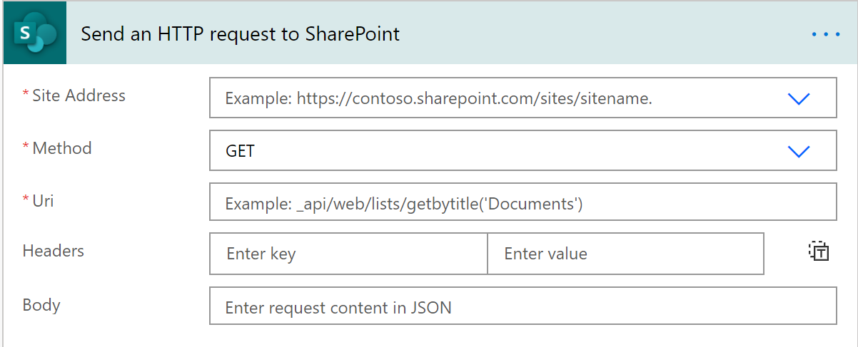
Send an HTTP Request to SharePoint
There are many features of classic SharePoint workflow that are not built-in to Power Automate, this is where an action such as Send an HTTP Request to SharePoint will be very valuable
Does not require a Premium License
Leverages REST API or CSOM
Commonly used with Parse JSON Action

Slide 55
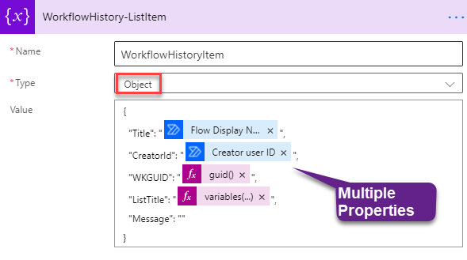
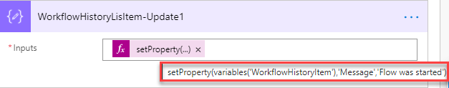
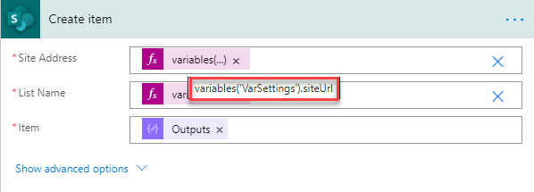
Convert many “Set Variable” to a JSON object
Many existing classic SharePoint workflow used a lot of “Set Variable” actions to set variables.
The large amount of “Set Variable” actions can be replaced by a “Initialize variable” action with an Object type in Power Automate.
An object type variable behaviors like a JSON object which can contain many properties.
Use variables(‘[variable-name]’).[property-name] to reference the property from a variable.
Leverage setProperty(), addProperty() to update or add a property to an existing object variable.
Please reference to SP2010WorkflowToPowerAutomate\WorkflowHistory-Sample.zip for details

